Slide 1
Analysis of Glassdoor Reviews for competitors – Thomson Reuters

Slide 2
Agenda
Executive Summary
Overall word cloud for Pros and Cons
What people liked (based on 5 star ratings)
What people liked (based on 4 star ratings)
What people liked (based on 3 star ratings)

Slide 3
Executive Summary
Objectives
Scrapping Glassdoor reviews for competitors given by their employees.
Analyzing reviews of competitors
Identify hidden patterns in data about employee engagement.
Key Observations
We scrapped more than 95% of reviews.
Total 7800 reviews were analyzed.

Slide 4
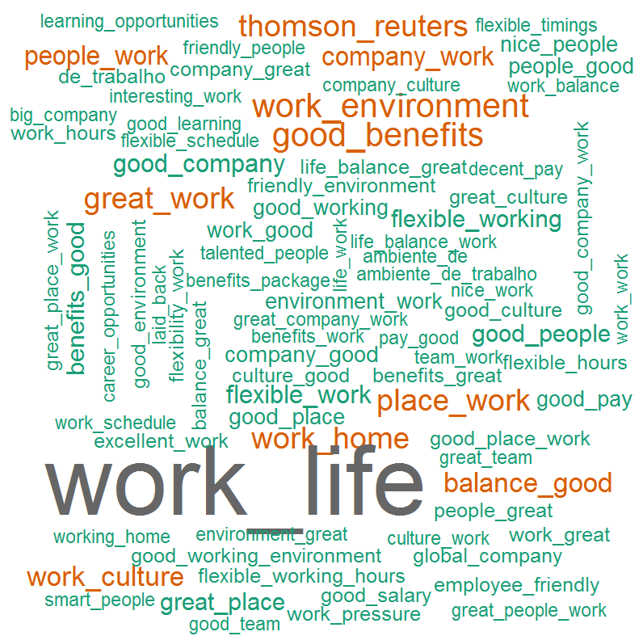
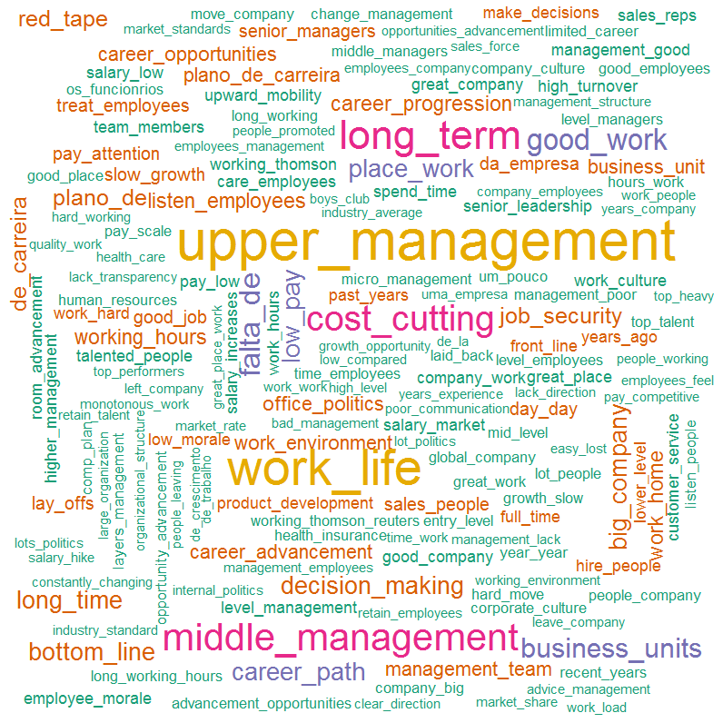
Overall Word Cloud for Pros and Cons
Word Cloud for Pros
Word Cloud for Cons
Good Words List –
Work life balance
Good work
Good benefits
Work environment
Great people
Work from home
Word List which people don’t like –
Senior / upper management
Work life balance
Career growth
Work life balance
Cost cutting
Career path
Low pay
Decision making

Slide 5
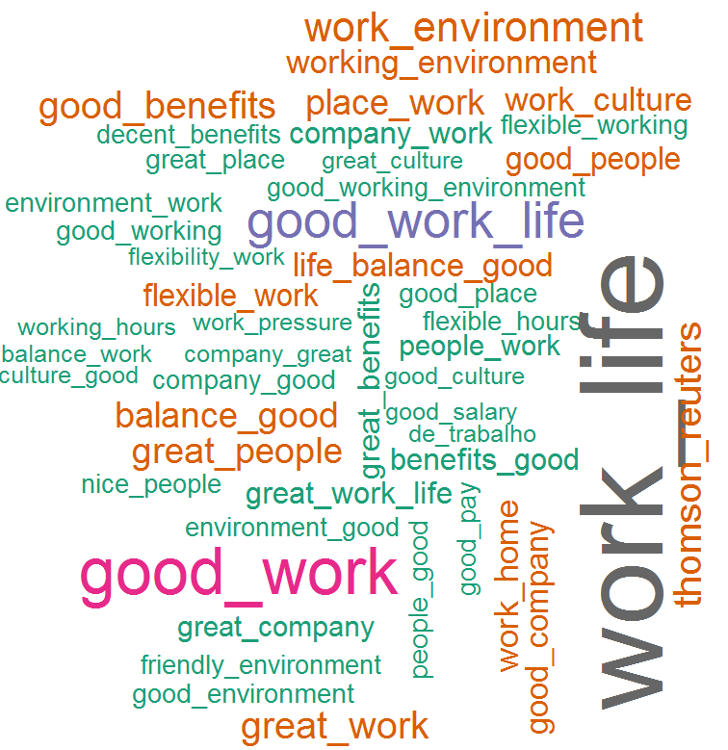
What people liked (based on 5 star ratings)
Word Cloud for Pros
Good Words List –
Work life balance
Good work
Work environment
Good benefits
Work from home
Work culture
Flexible work
Good people
Good pay
Friendly environment

Slide 6
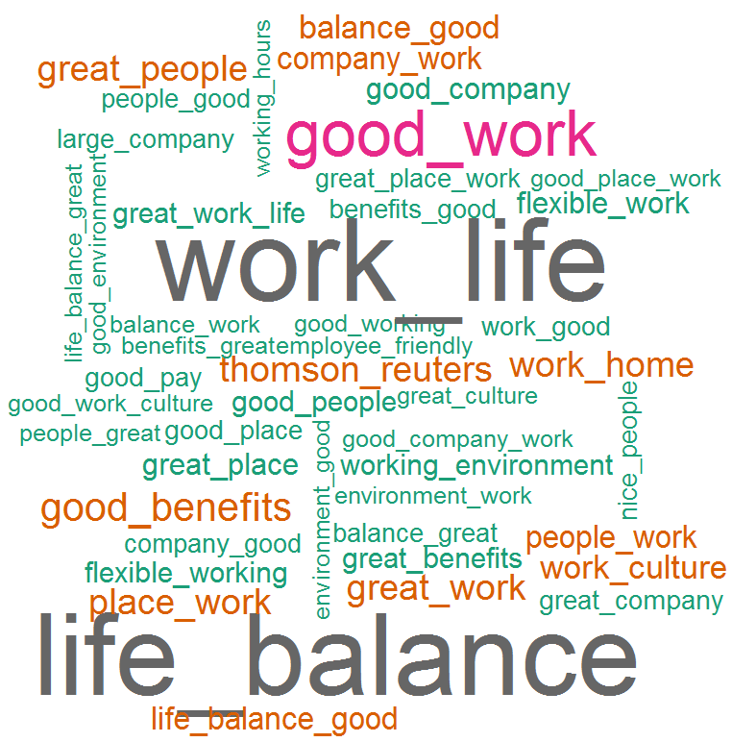
What people liked (based on 4 star ratings)
Word Cloud for Pros
Good Words List –
Work life balance
Good work
Good benefits
Work environment
Work from home
Work culture
Flexible work
Good people
Great company
Flexible work
Smart people

Slide 7
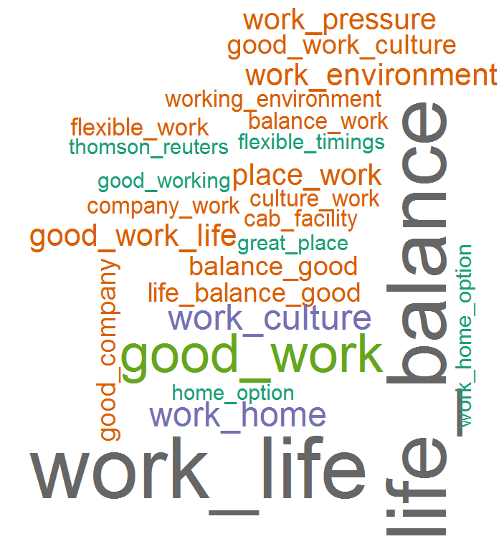
What people liked (based on 3 star ratings)
Word Cloud for Pros
Good Words List –
Work life balance
Good work
Work culture
Work from home
Work environment
Less work pressure
Good company
Flexible work
Cab facility
Flexible timings

